Slide 1

Medical Murder is the #1 Cause of Death in the U.S. – By Design (People Are Too Expensive – Satan’s Big Lie)
Why? The Esoteric Spiritual Battle

Slide 2

We’ve been programmed to believe lies – from all sides and angles

Slide 3
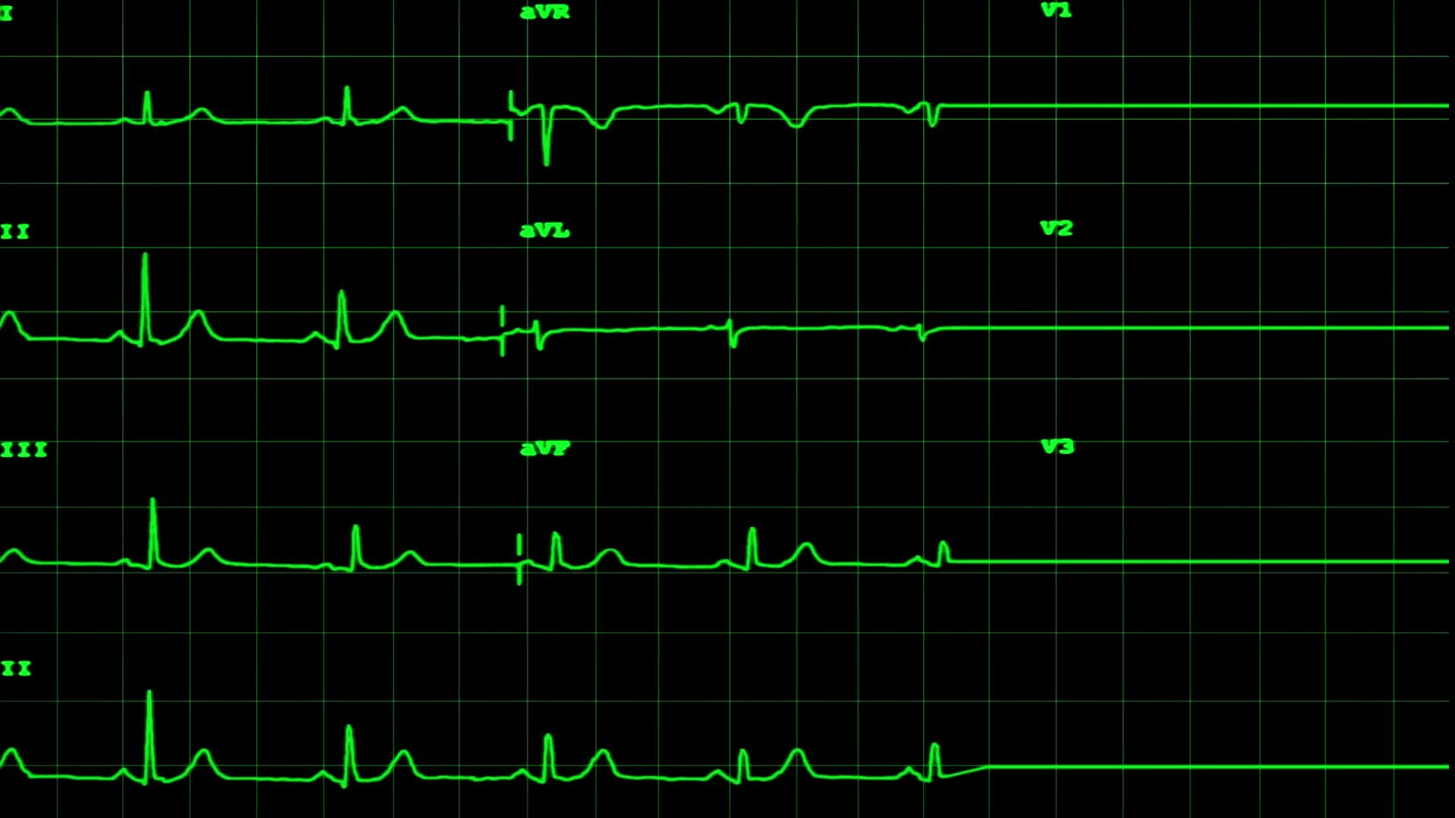
Facts:
Historical facts – pre-COVID
Annual deaths: 700K heart disease; 600K cancer; 400K medical “malpractice” (3rd leading cause of death)
https://www.statnews.com/2021/08/04/medical-errors-accidents-ongoing-preventable-health-threat/#:~:text=Injury%20or%20illness%20caused%20by,under%20wraps%20%E2%80%94%20and%20they%20are
Current facts – COVID Era and Post COVID
All cause mortality increase of 24% in vaccinated
https://www.israelnationalnews.com/news/317091
All cause mortality cumulative increase since January 2020 – weekly graph
https://ourworldindata.org/grapher/cumulative-excess-mortality-p-scores-projected-baseline?tab=chart&facet=none&country=~USA

Slide 4




The Spiritual Battle in Words, Audio, and Visual

Slide 5
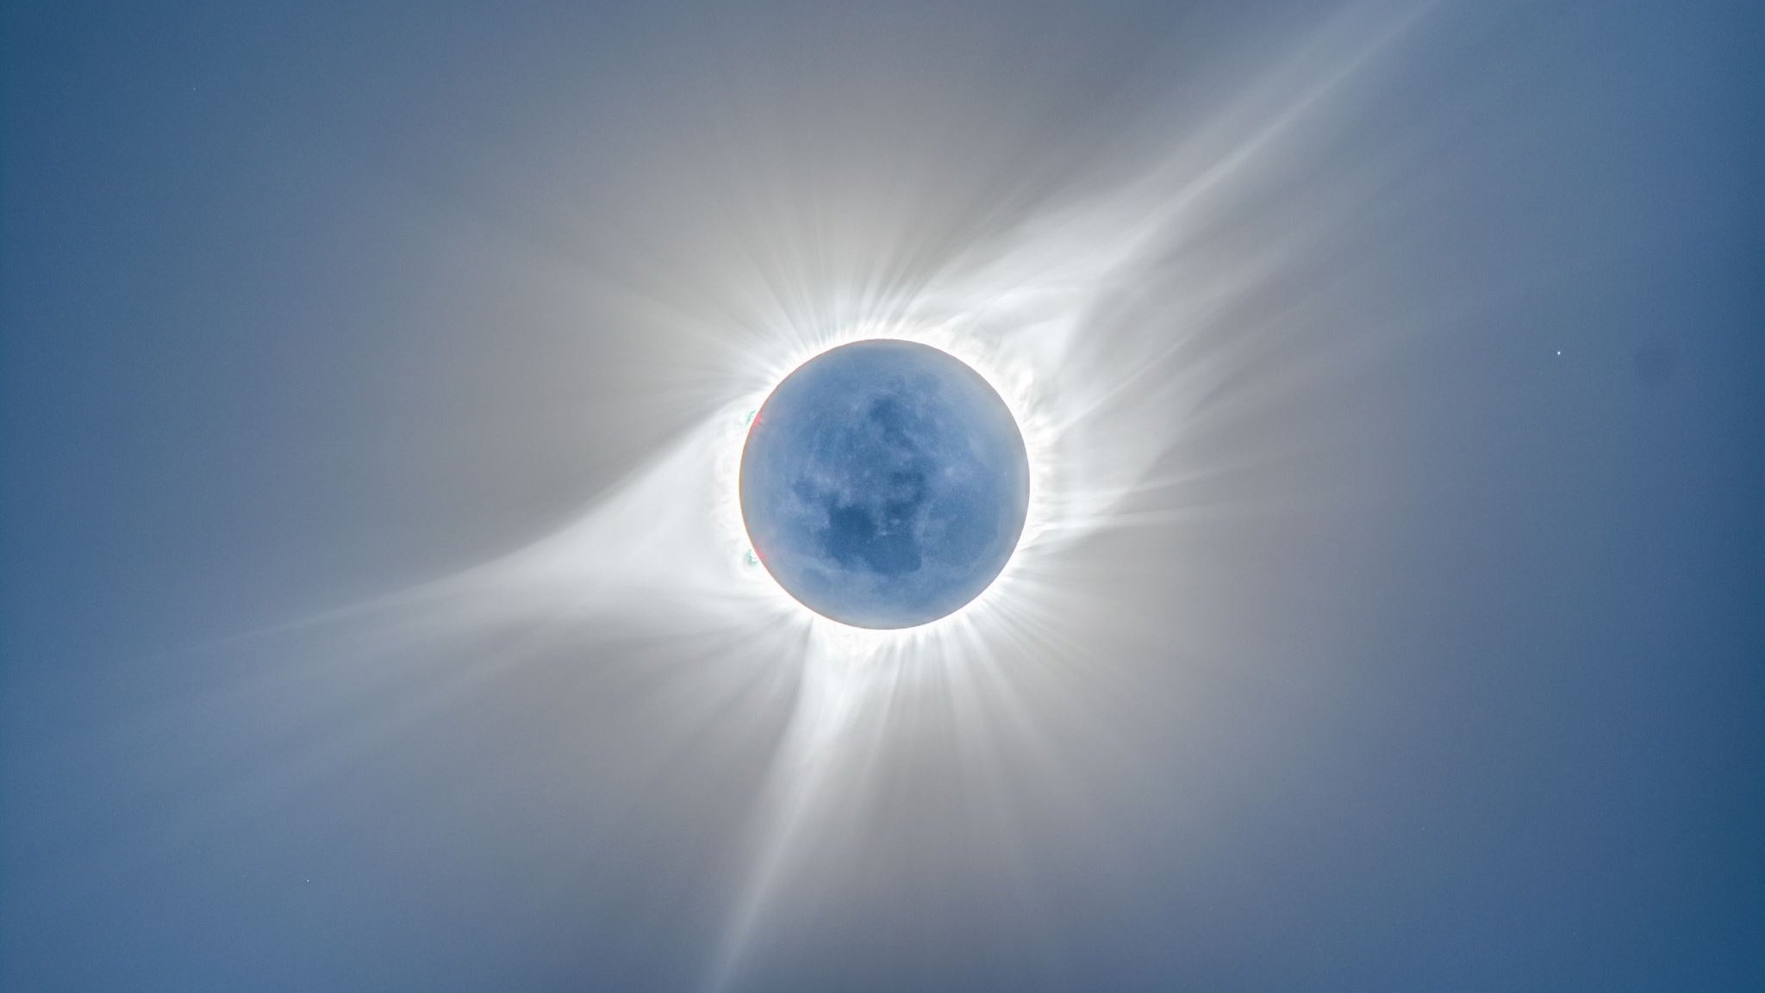
The First Recorded Sin of Man – to be Like God
Ephesians 6:12
For we do not wrestle against flesh and blood, but against the rulers, against the authorities, against the cosmic powers over this present darkness, against the spiritual forces of evil in the heavenly places
https://youtu.be/FmxDAf9OwXk
Satan hates God, so the battle is over souls, physically (death) and spiritually (believing in man vs. God)

Slide 6

What Does Each Side Offer?
God
Satan
Tree of Knowledge of:
Tree of Life
Evil
Good Less Evil

Slide 7
Conclusion: Satan lied – he could never be good; the trap has been set to wipe out God’s creation. Satan’s dual nature has a foothold – evil vs. less evil esoteric and exoteric dialectics become his tool to rule the Earth. Satan is the prince of this world, and our sin nature desires what he offers.

Slide 8


The anti-Christ First Beast System: the evil side – physical destruction

Slide 9

Big Lie #1 - People worship (we are our own god)
We foolishly believe a better president will fix things – the lessor of two evils…evil Democrats and less evil Republicans – an exoteric dialectic

Slide 10
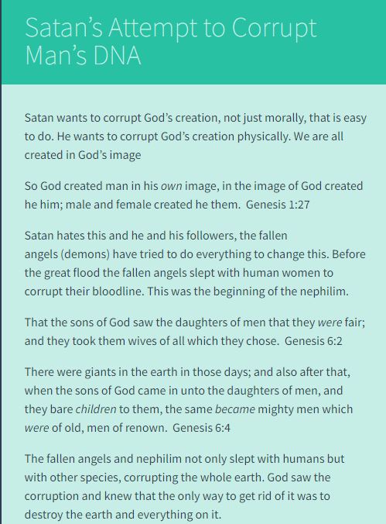
Transhumanism is the pinnacle of people worship – “we can live forever, like God”
The nephilim corrupted God’s seed, just like Transhumanism is doing today
https://endtimebibleprophecyblog.wordpress.com/2015/04/19/satans-attempt-to-corrupt-mans-dna/

Slide 11
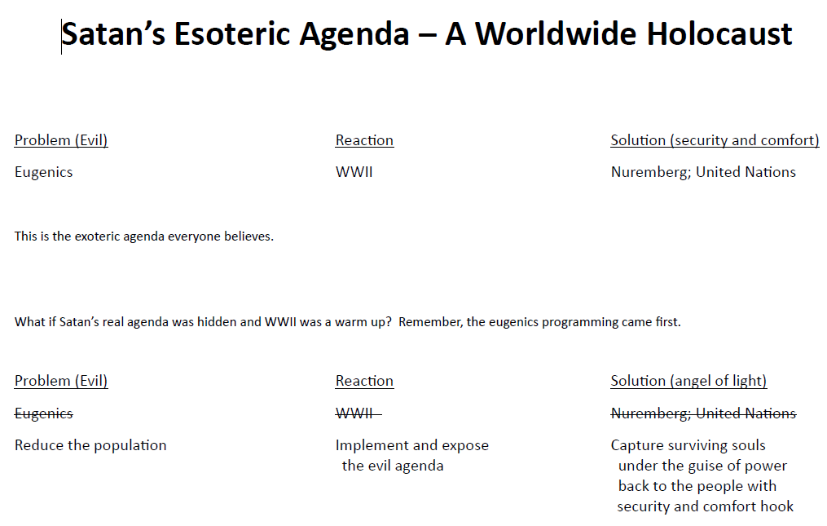
Fooled: People are too expensive $$

Slide 12

Big Lie #2 - Planet worship is the source of all kinds of lies leading to physical death of man as an excuse to save the planet

Slide 13
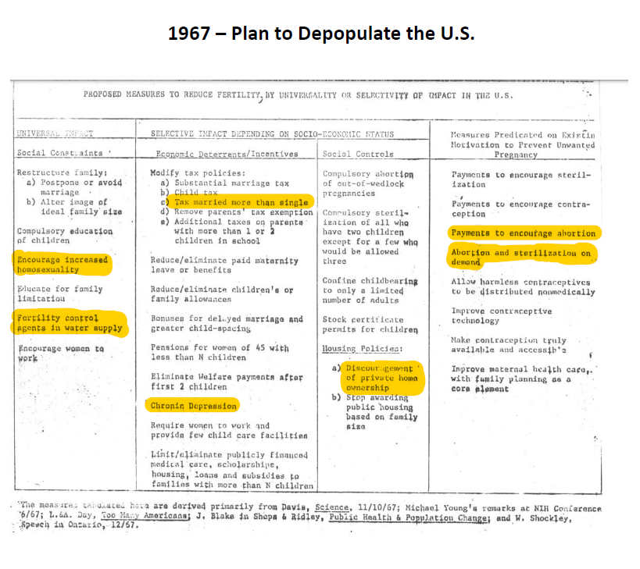

Slide 14
Scarce Resources Lie
1968 - 69 Weekly Reader – electric can opener; 2 children – can you see the agenda being implemented?
Andy Griffith Show, Green Acres, Leave it to Beaver – how many children? Why is the only person married, on Andy Griffith Show, the town drunk? A coincidence?
Laughter is good for the soul: https://www.youtube.com/watch?v=cFNNH3wCpEU

Slide 15

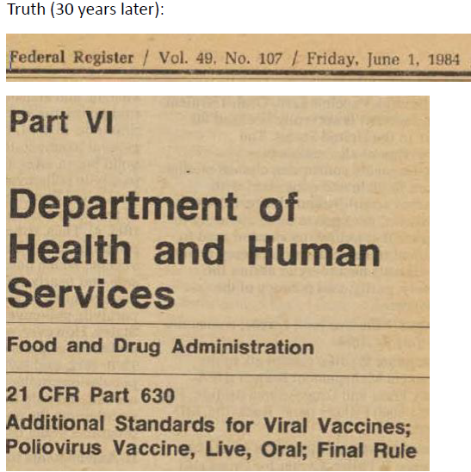
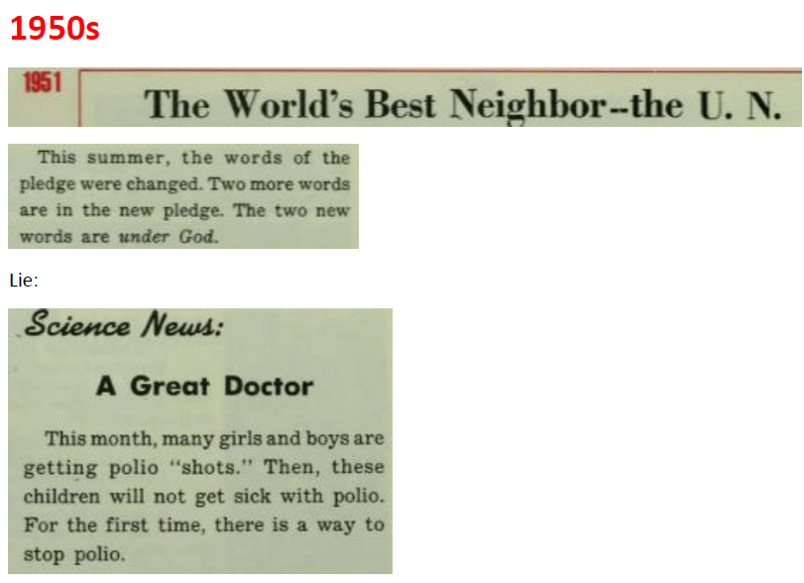
Small rabbit trail – did the innocent Weekly Reader really become a programming arm of the government?

Slide 16
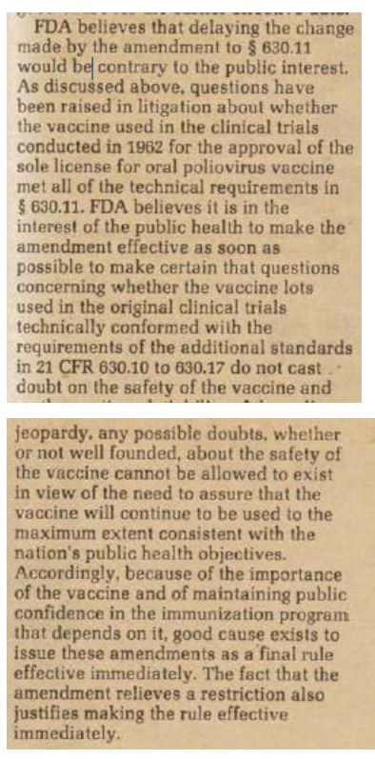
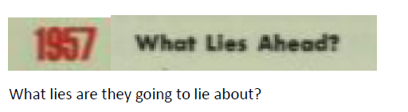
More…

Slide 17
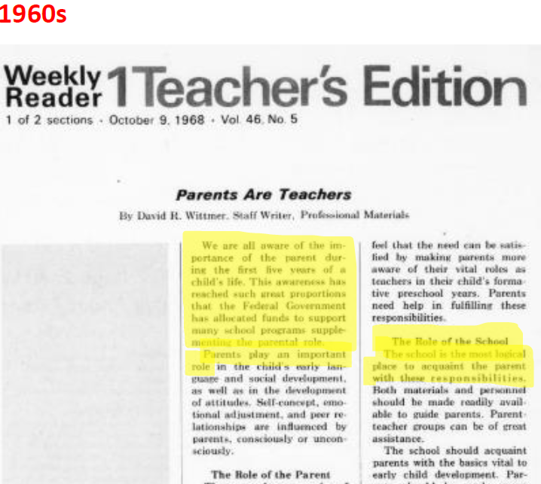


Slide 18
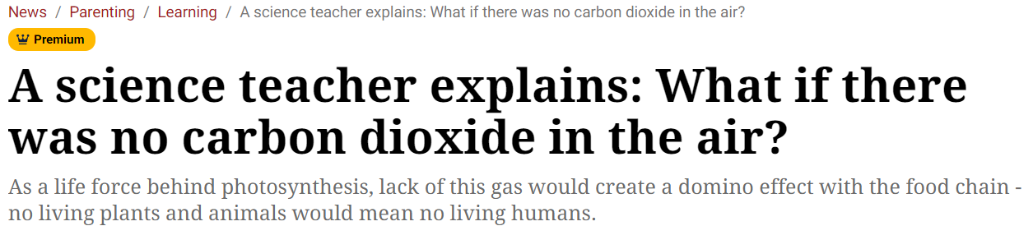

Reverence for the creation vs. the creator
https://rumble.com/v1y2xcu-the-global-evil-agenda-insights-from-alex-newman.htmlv (World view) https://www.youtube.com/watch?v=QNv9PRDIhes (Street Level view)

Slide 19
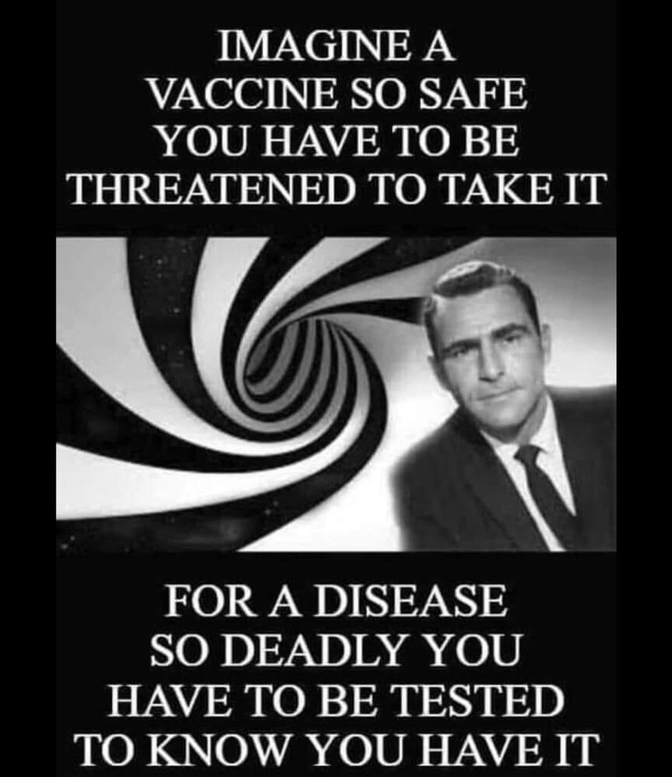
The race to expose evil
JFK Murder exposed evil – the Oliver Stone documentary; what was the real purpose?
To hide the evil behind the evil government, so the deception could continue.
“We have a corrupt government – let’s fix it!” No, it was by design!
Same playbook with Covid – “Let’s not let that mistake happen again!” – on steroids…

Slide 20
The continual focus on the Covid narrative is an exoteric dialectic disguising the esoteric agenda – reminder: Covid was a success, exoterically and esoterically, from the perspective of the Satanic agenda
Examples from past two weeks:
Whitehouse knew of myocarditis in May 2021 – no kidding; where’s the news in this fact?
Air Vax
mRNA in Breastmilk
Assuming you can hold the globalists to account (which takes more faith than believing in Jesus), it will take too long because of the anti-Christ legal system they set up
Are we really that narrowly focused (blind)? Yes, without God
https://www.youtube.com/watch?v=xNSgmm9FX2s

Slide 21
Conclusion: Deception facilitates physical destruction of man. Exposing this evil side sets up the “light” – the false light, while we are all focused on the evil, less evil is working just as hard to deceive us. Satan needs the evil side exposed in order to snap the last side of the control grid into place.

Slide 22

The false prophet Second Beast system (the less evil side) – spiritual destruction

Slide 23

The Great Deception?
2 Thessalonians 2:9-12: The coming of the lawless one will be in accordance with how Satan works. He will use all sorts of displays of power through signs and wonders that serve the lie, and all the ways that wickedness deceives those who are perishing. They perish because they refused to love the truth and so be saved. For this reason God sends them a powerful delusion so that they will believe the lie and so that all will be condemned who have not believed the truth but have delighted in wickedness. [Paul writing to Christians]

Slide 24

The angel of light
2 Corinthians 11:14-15: And no wonder, for Satan himself masquerades as an angel of light. It is not surprising, then, if his servants also masquerade as servants of righteousness. Their end will be what their actions deserve.

Slide 25
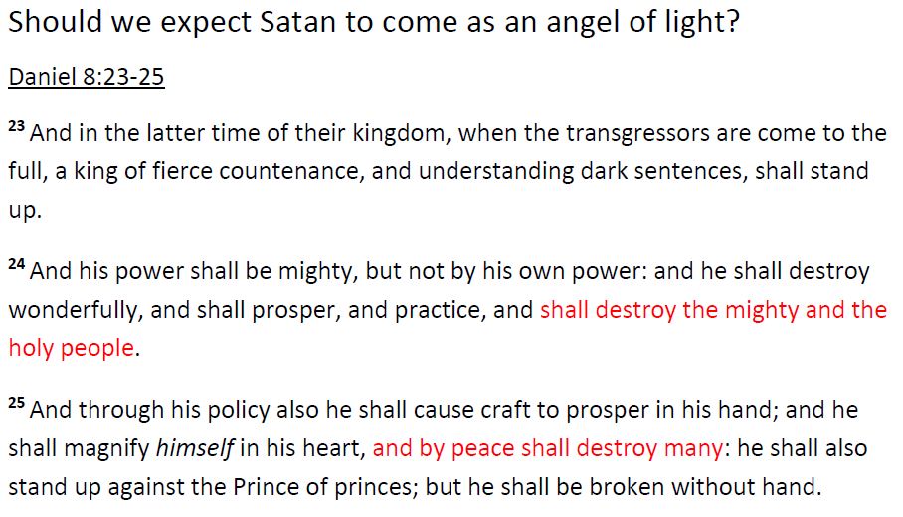
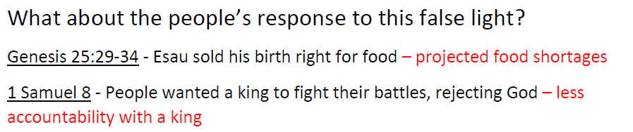
Matthew 24:24: For false messiahs and false prophets will appear and perform great signs and wonders to deceive, if possible, even the elect.

Slide 26

Will Covid amnesty be a tool to fool?
The ‘mark’ offered by the second beast system may include: gold backed system; debt jubilee; prosperity funds; stopping child trafficking; military tribunals; replacing the Cabal propaganda – expect the false prophet system to look very appealing, but absent of God…

Slide 27
Conclusion: The desire to have the evil end, and our propensity to be trapped by the security and comfort idol, snaps the final piece of the control grid into place.

Slide 28


Don’t be deceived

Slide 29
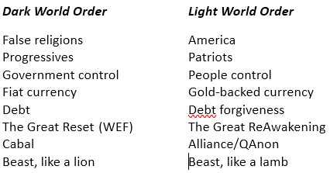
Satan’s use of the Hegelian Dialectic
problem = evil;
reaction = fear;
solution = angel of light

Slide 30
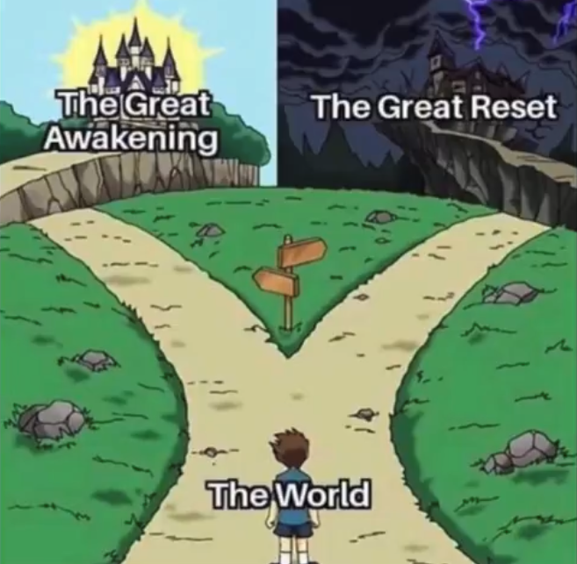
God’s way is outside of the programmed choices Satan has us believing
Q: What’s missing?
A: Repentance

Slide 31
Final thoughts…
My focus is on repentance and getting right with God because time is short - God’s judgment is overdue. I can’t tell you if I’m right or wrong. I know this message was put on my heart by God.
Where are we on God’s timeline? No one knows other than the Father. We can know that where we are at, with all the evil we are experiencing, didn’t happen overnight.
Pastor Matt Trewhella, the author of ‘The Doctrine of the Lesser Magistrates,’ explains, “the more insane the rebellion, the more insane the consequences.”
We have rebelled against God, slowly at first and rapidly today, and are experiencing severe consequences. What’s God’s purpose in this law? To bring us to repentance. If we repent, He will save us. If we don’t, He will destroy us.

Slide 32
Conclusion: There’s been an orchestrated convergence, giving an illusion of choice, but instead trapping its slaves to depend on the government for everything. We’re being played: “US in shock trying to figure out what happened while satanic agenda continues!” There’s never been a more urgent time to submit to the real King. He is the only one who can protect us.

Slide 33
Medical Murder is the #1 Cause of Death in the U.S. – By Design (People Are Too Expensive – Satan’s Big Lie) Up Next…
When? What Began in the Garden Continues Today

